Slide 1
Gamepad Driver
Joshua Chang
Vineeth Voruganti
Srikar Tallapragada

Slide 2
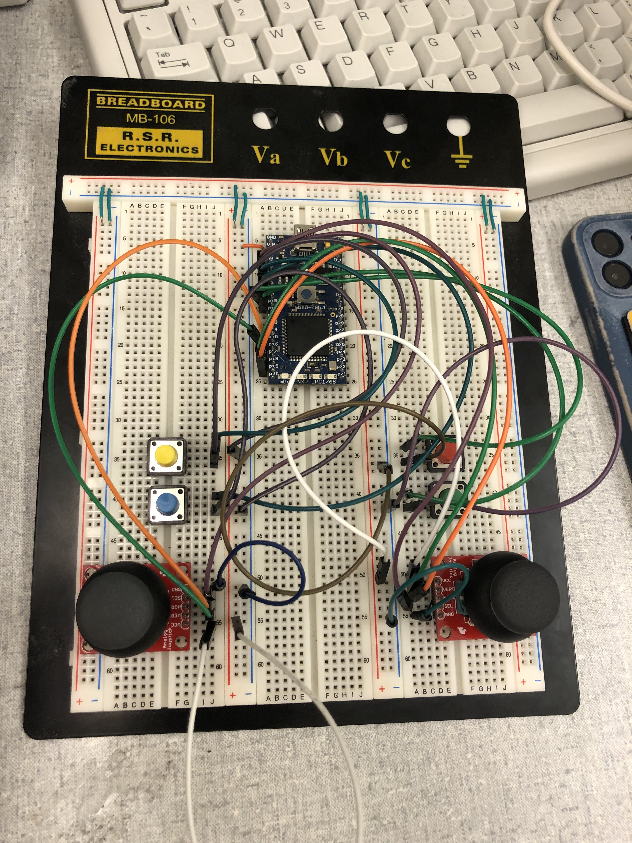
Overview
Create a controller that can interact with windows software
Use Joy.cpl to verify functionalities
Run simple games on windows
Zero Ranger
Pacman

Slide 3
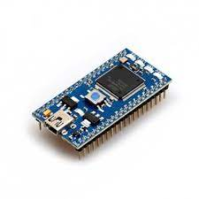
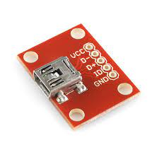
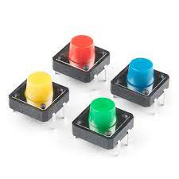
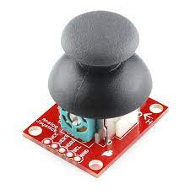
Hardware
Mbed LPC1768
Sparkfun Joysticks
Sparkfun Pushbuttons
Sparkfun USB Mini-B Breakout Board

Slide 4
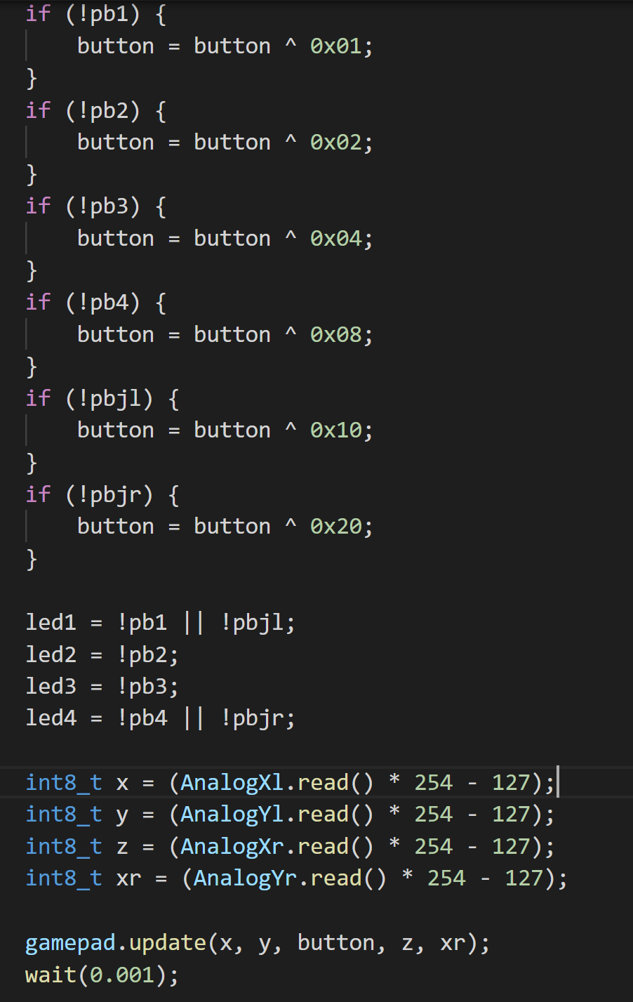
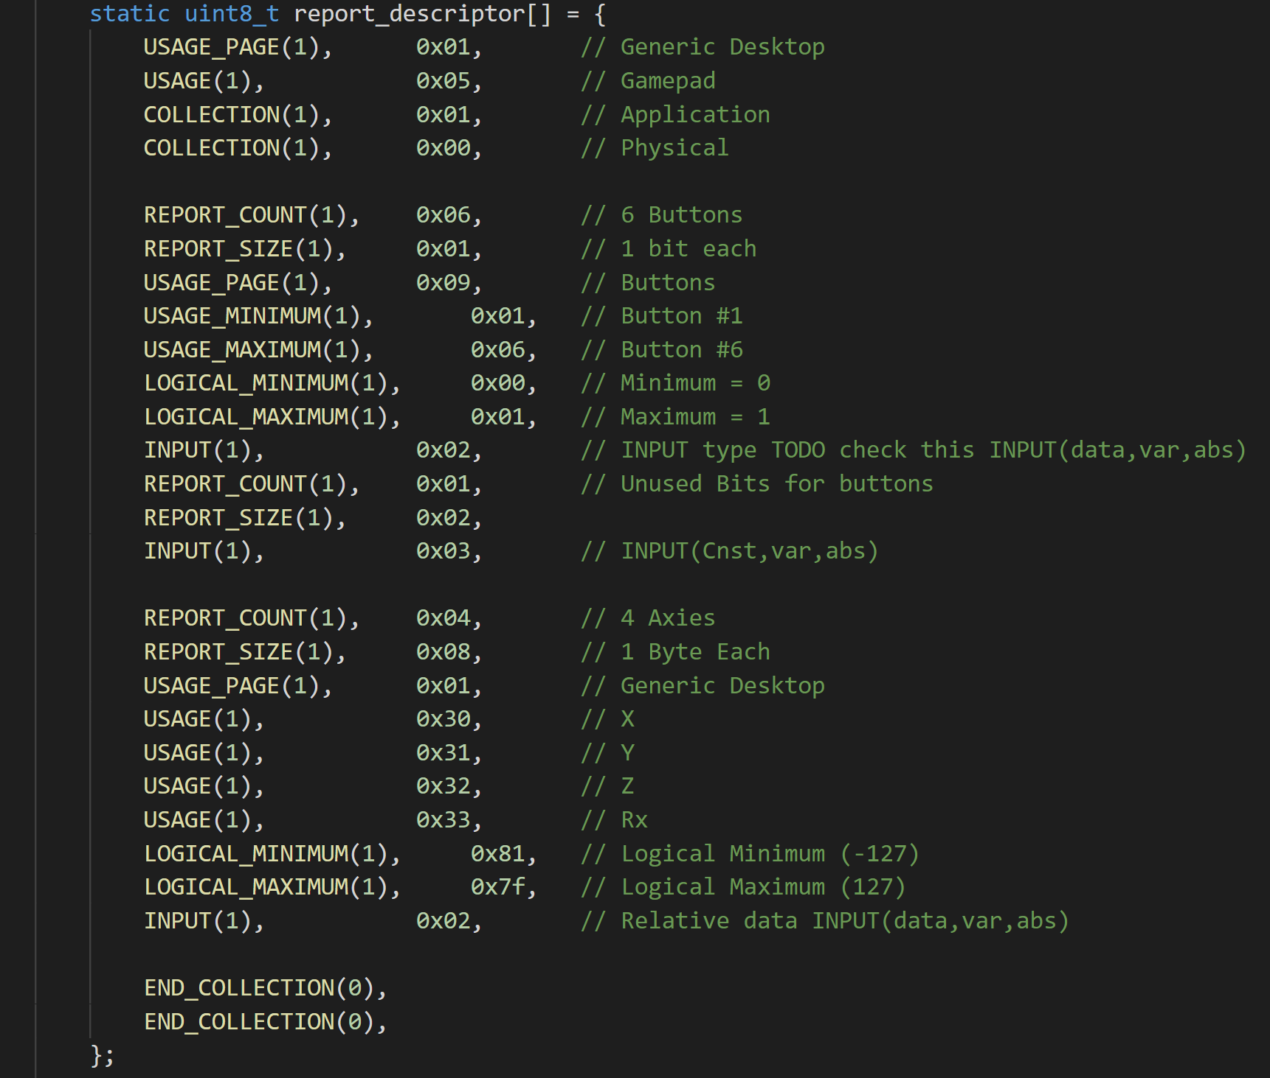
Software

Slide 5

Demo

Slide 6
Future Implementations
Implement more features/functionalities
More hardware inputs
Create a more ergonomic design
Focus on aesthetics of controller
Software updates/clean up
More configurable descriptor

